Slide 1


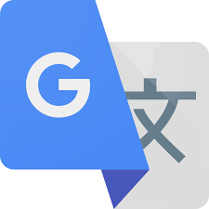

사용자
잔디체커
Google Cloud
Translation API
ChatGPT
“플러터 vs 리액트 네이티브
뭐가 나은가?”
“플러터 vs 리액트 네이티브
뭐가 나은가?”
“Which one is better?
Flutter? Or RN?”
“Which one is better? Flutter? Or RN?”
“Flutter is better”
“Flutter is better”
“플러터가 낫습니다＂
“플러터가 낫습니다＂

